Slide 1


CAPSTONE PROJECT
OLIST e-COMMERCE SALES & PERFORMANCE ANALYTICS
Presented By
Student Name: Kuldeep R. CHOUDHARY
College Name: Department of Technology , SPPU
Department: B.Tech Data Science
Email ID: kuldeeprc2021@gmail.com

Slide 2
OUTLINE:
Problem
Proposed System/Solution
System Development Approach
Data modelling & Dashboard Development
Result (Output Image)
Conclusion
Future Scope
References

Slide 3
Problem Statement:
As a major e-commerce platform, Olist generates massive volumes of raw, decentralized daily data across millions of orders, diverse product categories, and widespread customer locations. However, this raw data in its tabular form offers no immediate strategic value, leaving business leaders and inventory managers unable to quickly identify revenue-driving products, pinpoint underperforming inventory, or understand the geographic distribution of their most valuable customers. This critical lack of clear, centralized data visibility creates significant strategic blind spots, ultimately leading to inefficient inventory management, misallocated marketing budgets, and suboptimal logistical planning across different regions.

Slide 4
PROPOSED SOLUTION
The proposed system aims to address the critical lack of data visibility by engineering a comprehensive, interactive Business Intelligence (BI) dashboard utilizing Microsoft Power BI. This involves leveraging advanced data analytics, ETL (Extract, Transform, Load processes, and relational data modeling to translate millions of rows of raw transactional data into actionable business insights.
The solution consists of the following components:
Data Collection & Integration:
Gather extensive historical e-commerce data across multiple operational domains, specifically focusing on customer demographics, product catalog details, order fulfillment timestamps, and granular transaction values.
Integrate these disparate CSV datasets (Orders, Items, Customers, Products) into a centralized, interconnected repository to establish a single source of truth for organizational metrics.
Data Preprocessing & Feature Engineering
Clean and preprocess the collected data using Power Query to handle missing values, resolve data inconsistencies, and standardize formats.
Perform feature engineering to extract relevant data points, such as isolating 'Year' and 'Month' from complex timestamps to enable accurate time-series revenue forecasting, and formatting location data for spatial mapping.

Slide 5
Data Modeling & DAX Implementation:
Architect a robust Star Schema relational data model, actively linking dimension tables (Customers, Products) to the central fact tables to enable seamless cross-filtering.
Implement advanced Data Analysis Expressions (DAX) to engineer dynamic Key Performance Indicators (KPIs)—such as Total Revenue, Distinct Customer Count, and Average Freight Value—that recalculate instantly based on user context.
Interactive Deployment:
Develop a user-friendly, multi-page interface divided into logical business segments: Executive Overview, Product Performance Deep-Dive, and Customer Geographic Insights
Deploy advanced visual analytics, including interactive geographical maps, target-tracking Gauge charts, conditional Matrix formatting, and Top-N/Bottom-N filtering to highlight the most and least profitable inventory.
Evaluation & Refinement:
Assess the system's performance by validating DAX calculations against raw data totals to ensure absolute metric accuracy.
Fine-tune the user experience based on analytical best practices, incorporating seamless page navigation buttons and synced timeline slicers to ensure business stakeholders can effortlessly extract insights.

Slide 6
System Approach:
The development of this Business Intelligence system followed a structured, phased methodology to transform raw e-commerce data into an interactive analytical tool:
Data Ingestion (Extraction): Extracted raw, disparate CSV datasets (Orders, Customers, Products, Items) directly from the Olist dataset into Power BI Desktop.
ETL Process (Transformation): Utilized Power Query Editor to clean and shape the data. This included standardizing data types, handling null values, and parsing complex timestamp columns into usable 'Year' and 'Month' formats for time-series analysis.
Relational Data Modeling: Designed a Star Schema architecture. Centralized the transaction data as fact tables, and created active one-to-many relationships with dimension tables (Customers, Products) to enable seamless cross-filtering across the entire application.
Analytical Engineering (DAX): Developed custom Data Analysis Expressions (DAX) to create dynamic, aggregated measures—such as Total Revenue, Distinct Customer Count, and Average Freight Value—that instantly recalculate based on user slicer inputs.
Visualization & UI Design: Constructed a three-page, app-style interactive dashboard focused on user experience. Implemented advanced visual elements (Treemaps, Gauge charts, Geographic Maps) and Top-N dynamic filtering to specifically address the core business problems.

Slide 7
Data Modeling & Deployment:
Analytical Engine Selection:
Provide a detailed overview of the chosen architecture. Instead of a machine learning model, this project utilizes a Star Schema Relational Data Model powered by the VertiPaq analytical engine in Power BI. This architecture was explicitly chosen over flat-file analysis because it optimizes query performance across large datasets and enables seamless, multidimensional cross-filtering between fact tables (Orders) and dimension tables (Customers, Products).
Data Input & Feature Integration:
Specify the input features driving the analytical engine. The primary inputs include transactional data (price, freight_value), categorical metadata (product_category_name, order_status), temporal features (order_purchase_timestamp), and spatial attributes (customer_city, customer_state). Engineered features, such as distinct counts of order_id and customer_id, are integrated to calculate aggregate business metrics accurately.
Data Transformation & Measure Processing:
Explain how the raw data is structured and calculated to generate insights. Instead of algorithmic training, the data undergoes rigorous ETL processing via Power Query. Custom Data Analysis Expressions (DAX) are formulated to dynamically compute Key Performance Indicators (KPIs) such as Total Revenue and Unique Customers. The data model is optimized by establishing active one-to-many relationships, ensuring that context transitions (e.g., applying Top-N filters) cascade accurately across all visual elements.
Interactive Deployment & Insight Generation:
Detail how the deployed system delivers real-time business intelligence to end-users. The modeled data is deployed via a multi-page, interactive dashboard interface. When a stakeholder interacts with the system—such as adjusting the timeline slicer or selecting a specific geographical region on the density map—the underlying DAX engine instantly recalculates the tables and updates all connected visualizations (Treemaps, Gauge charts, Matrices) to provide immediate, actionable insights.

Slide 8
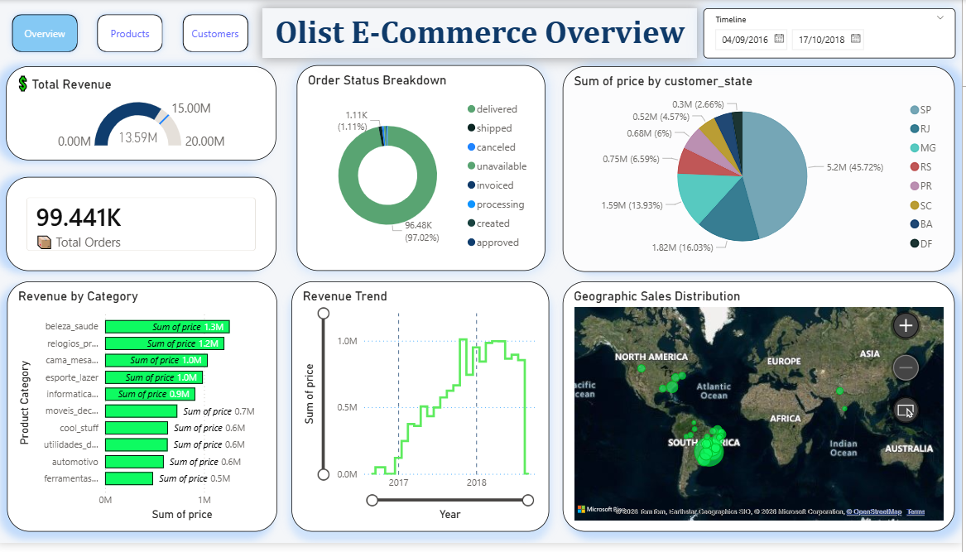
Result:
Executive Overview displaying $13.59M Total Revenue and geographical sales distribution.

Slide 9
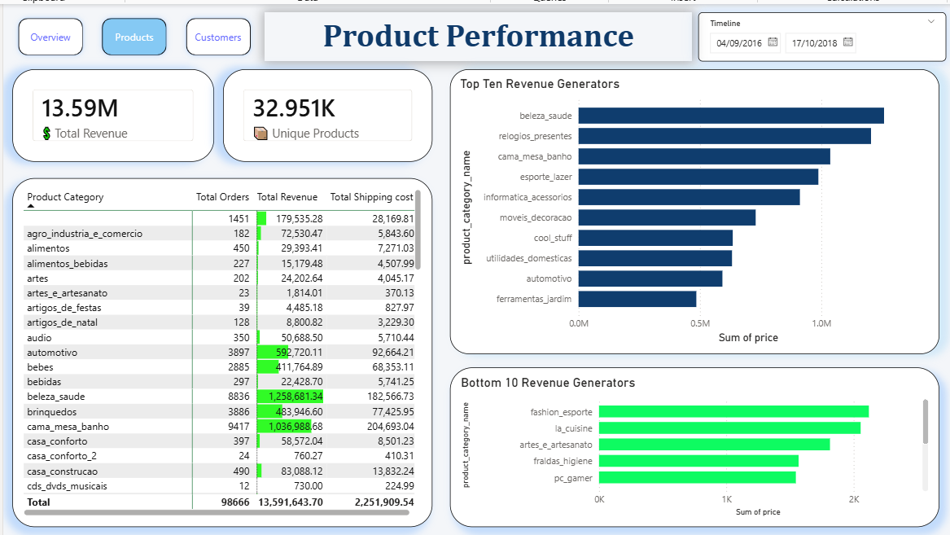
Product Performance Deep-Dive featuring conditional data bars and Top/Bottom 10 Revenue Generators.

Slide 10
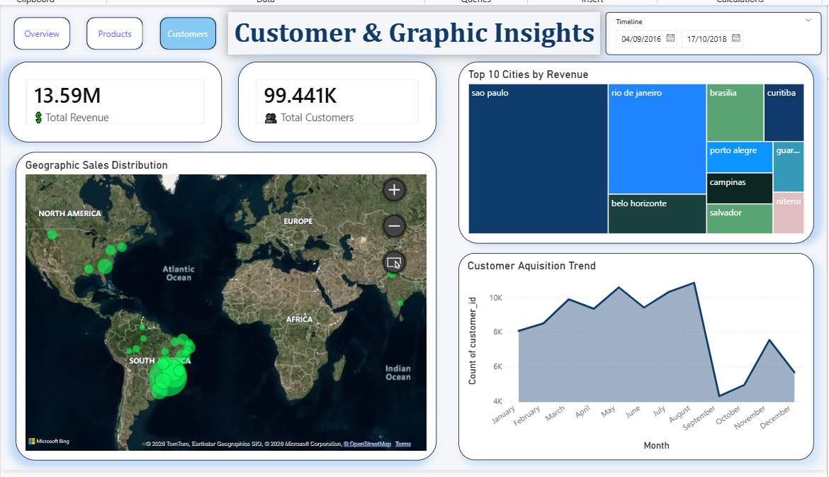
Customer Geographic Insights featuring an interactive density map and Treemap of Top 10 Cities.

Slide 11
Conclusion:
The proposed solution effectively transforms disjointed e-commerce data into a strategic business asset. By implementing a relational data model and interactive visualizations, the dashboard successfully highlights critical trends—such as identifying beleza_saude (health & beauty) as a primary revenue driver and pinpointing high-density customer regions like São Paulo. Emphasizing the importance of clear data visibility, this tool empowers stakeholders to make accurate, data-backed decisions regarding inventory management and targeted regional marketing.

Slide 12
Future scope:
Predictive Analytics::
Incorporate machine learning algorithms to forecast future month-over-month sales and bike/product demand.
Logistics & Delivery Optimization :
Expand the system by analyzing delivery timestamp data to track "On-Time vs. Late" delivery rates, optimizing shipping efficiency.
Sentiment Analysis:
Integrate the provided customer reviews dataset to correlate product ratings with overall sales performance.

Slide 13
References:
Olist Brazilian E-commerce Public Dataset (Kaggle).
Microsoft Power BI DAX and Data Modeling Official Documentation.
Best practices in data preprocessing and visualization techniques.
GitHub Link: Link

Slide 14
Thank You

